Slide 1

School of Computer Science and Engineering
Full-Stack based Lung Cancer Risk Prediction using ML, DL, and QML
Team members:
USN 1RVU22CSE145 - SHASHANK G
USN 1RVU22CSE112 - NITHISH N
USN 1RVU23LCSE005 -PRUTHVIRAJ R
USN 1RVU23LCSE007 - SHRINIDHI R
Project Guide:
Prof. CVSN REDDY
School of Computer Science and Engineering
RV University, Bangalore

Slide 2
Outlines
Introduction
Problem statement
Scope and Application Area
Objectives and expected outcomes
References

Slide 3
Introduction
Lung cancer is one of the leading causes of cancer-related deaths worldwide, with late detection being a major contributor to poor survival rates.
While medical diagnosis requires clinical tests and expert evaluation, data-driven risk prediction models can assist in early risk awareness and preventive screening decisions.
Machine learning helps analyze large healthcare data to find patterns that can predict disease risk.
This project presents a full-stack lung cancer detection system that compares machine learning, deep learning, and quantum machine learning (QML/QNN) models to predict cancer risk based on patient data.

Slide 4
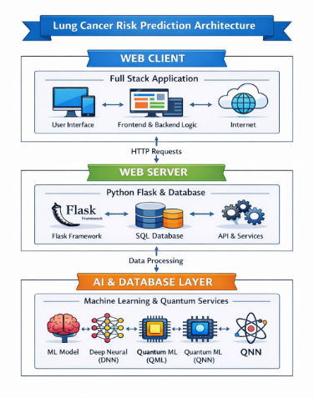
System Architecture

Slide 5
Problem Statement
Early identification of individuals at high risk of lung cancer is challenging due to multiple influencing factors such as age, smoking habits, work environment, and family history.
Existing machine learning approaches for lung cancer risk analysis show varying performance across different datasets and evaluation metrics.
There is a lack of a unified framework to systematically compare traditional machine learning, deep learning, and quantum machine learning (QML/QNN) models.
This project aims to develop a full-stack system to evaluate and compare these models for lung cancer risk prediction using structured healthcare data.

Slide 6
Scope and Application Area
Scope
What we implement:
Use publicly available and anonymized datasets such as UCI and Kaggle healthcare datasets.
Focus on lung cancer risk prediction rather than clinical diagnosis.
Implement and compare traditional machine learning, deep learning, and quantum machine learning (QML/QNN) models.
Evaluate model performance using standard metrics and basic statistical analysis.
Develop a simple full-stack web interface for user data input and visualization of prediction results.
What we do not implement:
Real-time or clinical lung cancer diagnosis.
Advanced medical imaging analysis such as CT or X-ray image processing.
Application Areas
Healthcare risk analytics
Preventive health screening systems
Clinical decision support research
Medical data science studies

Slide 7
Objectives and Expected Outcomes
Objectives:
To apply lung cancer datasets on machine learning, deep learning, and quantum machine learning (QML/QNN) models.
To preprocess and prepare healthcare data for effective model training and evaluation.
To compare different models based on performance metrics such as accuracy and error rates.
To analyze model behavior using feature importance and interpretability techniques.
To enable the complete system through a full-stack architecture.
To develop a simple web-based GUI for user input and visualization of prediction results.

Slide 8
Expected Outcomes:
Comparative analysis of ML, DL, and QML/QNN models for lung cancer risk prediction.
Identification of the most reliable model based on accuracy, false positives, and stability.
Objective model evaluation using standard performance metrics and explainability methods.
A working full-stack web prototype demonstrating lung cancer risk prediction.

Slide 9
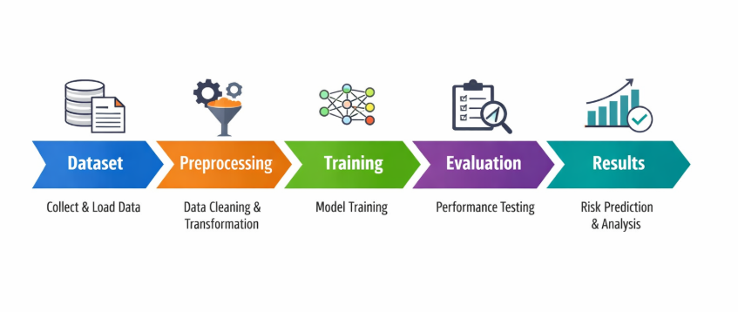
System Workflow

Slide 10
References
References
[1] K. Mohan and B. Thayyil, “Machine learning techniques for lung cancer risk prediction using text dataset,” International Journal of Data Informatics and Science, vol. 3, no. 2, pp. 45–54, 2023.
[2] S. A. Khan, M. Alam, and R. Gupta, “Lung cancer risk prediction using machine learning techniques,” Journal of Scientific Research, vol. 14, no. 1, pp. 89–97, 2021.
[3] J. Liu, Y. Wang, and X. Zhang, “Improving lung cancer risk prediction using ensemble machine learning models,” IEEE Access, vol. 9, pp. 112345–112356, 2021.
[4] A. Sharma and P. Verma, “Lung cancer risk analysis and prediction using machine learning approaches,” Health Science and Engineering Journal, vol. 5, no. 3, pp. 210–218, 2022.
[5] R. Patel, N. Shah, and K. Desai, “Explainable machine learning for lung cancer risk prediction,” Computers in Biology and Medicine, vol. 146, pp. 105558, 2022.

Slide 11
Conclusion
This project presents a comprehensive full-stack framework for lung cancer risk prediction by systematically comparing traditional machine learning, deep learning, and quantum machine learning (QML/QNN) models using structured healthcare data. By focusing on early risk assessment rather than clinical diagnosis, the system highlights how data-driven approaches can support preventive healthcare and risk awareness. The comparative evaluation using standard performance metrics and interpretability techniques helps identify reliable and stable models while providing insights into key risk factors influencing predictions. The developed web-based interface further demonstrates the practical applicability of the system, making the results accessible and understandable to users.

Slide 12
THANK YOU

